Slide 1


500 Queens VC
Profiling Possible Queens
100 New Female Founder Startups in Queensland, Australia 2021
Profiling Possible Queens.
Presented By:
Luke Catalyst Nathan Hayes
https://youtube.com/playlist?list=PL9jLSm_Ni6aH-mKHflIbnavMhTPDByV7e
Disclaimer: All 100+ Start-ups will have female CEOs, plus have majority female executive. All other genders are welcome.

Slide 2

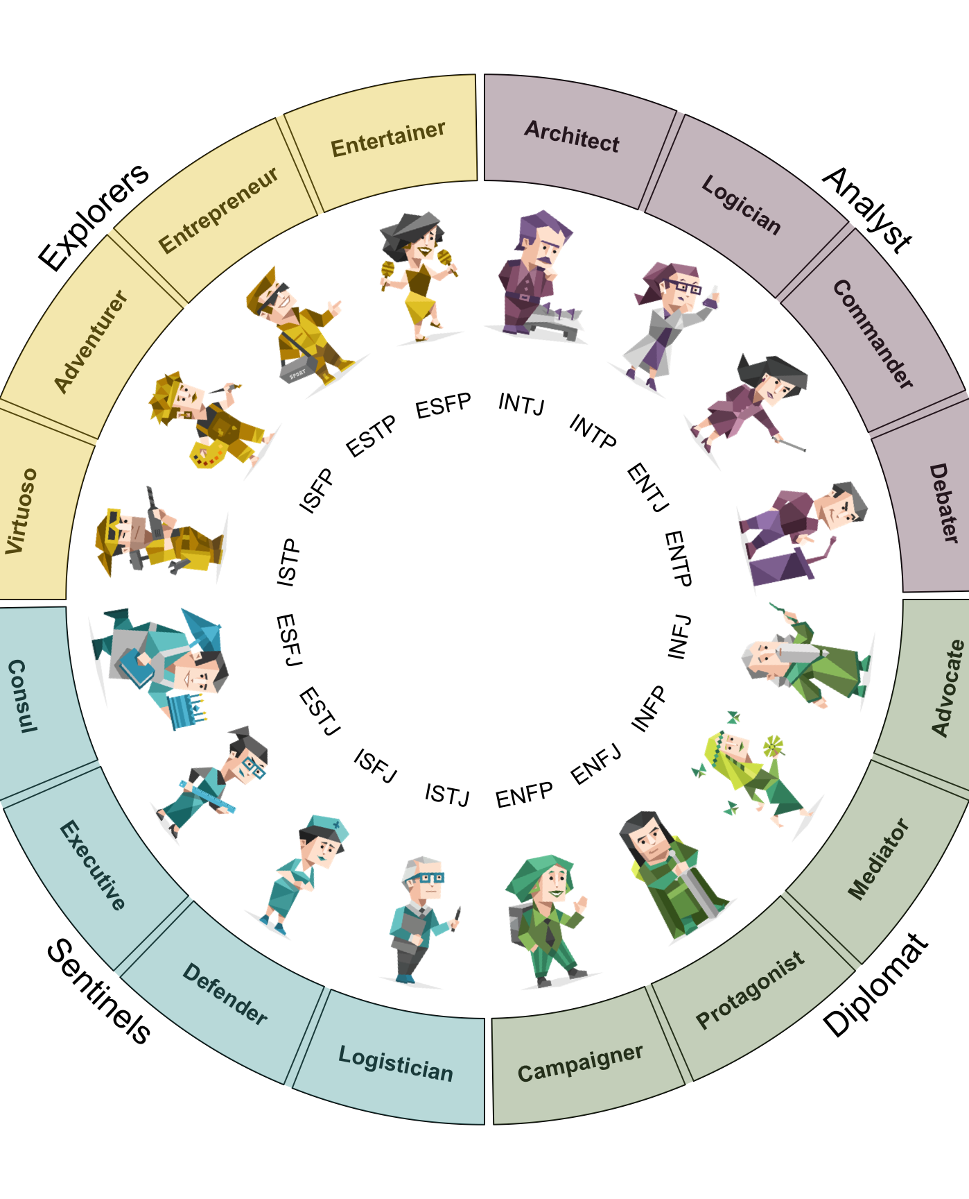


Profiling Queens
Understanding Characteristics and Compatibility
Mitigate Potential of Conflicting Interests and Akrasia
Streamlined Goal Setting and Performance Management

Slide 3
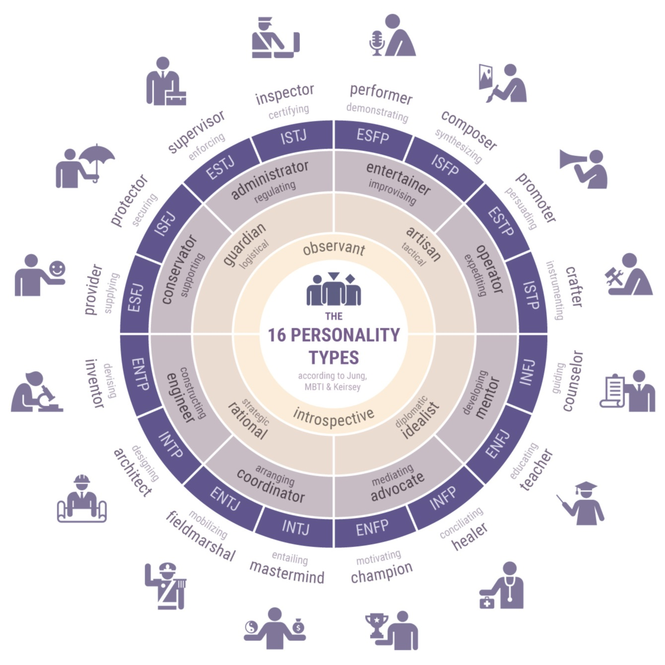

Understanding Characteristics & Compatibility
Myers Briggs 16 Personalities
Self Reflection Meditations
Aura of Intelligence Development
Leadership and Team Building
Health and Wellbeing Assessment
Police Check, Education & Work History

Slide 4
Understanding Family and Associates
Family and Friends
Lovers and Children
Associate Networks
Are family and friends supportive of your choices or do they play Devil’s Advocate by undermining you?
How large and diverse is your family and friends network and what are their native biases?
How much time do you prefer to spend with them, and would you prefer more, less or the same?
How might 500 Queens VC build a safe setting to discuss love and life?
Do you have children or want to have children? If yes, what is more important; intermittent retirement or flexible work life balance?
Is free childcare important to you?
What do you think about the concepts of intermittent retirement versus parental/maternity leave?
What professional and social groups or associations are you a member of?
Do you have any special associates who might be well placed to support the 500 Queens Initiative?
Might any of your associates, groups or associations cause a direct conflict of interest with your/our aspirations?
Are there any groups or associations you want to join but haven’t yet?

Slide 5
First 13 Weeks
Approx. 300 to 500 hours
60+ Hours Non-VR plan & Software Tutorials
40+ Hours in VR Set-up of:
Virtual Offices & Spaces
Virtual Public Speaking Practice
Virtual Aura & Life Logging
100+ Hours Product Development
100+ Hours Business Development
200+ Hours Training & Refinement

Slide 6
Second 13 Weeks
Approx. 300 to 500 hours
60+ Hours Non-VR plan & Software Tutorials
40+ Hours in VR Set-up of:
Virtual Offices & Spaces
Virtual Public Speaking Practice
Virtual Aura & Life Logging
100+ Hours Product Development
100+ Hours Business Development
200+ Hours Training & Refinement

Slide 7
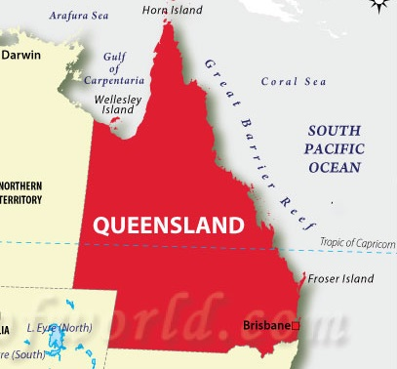
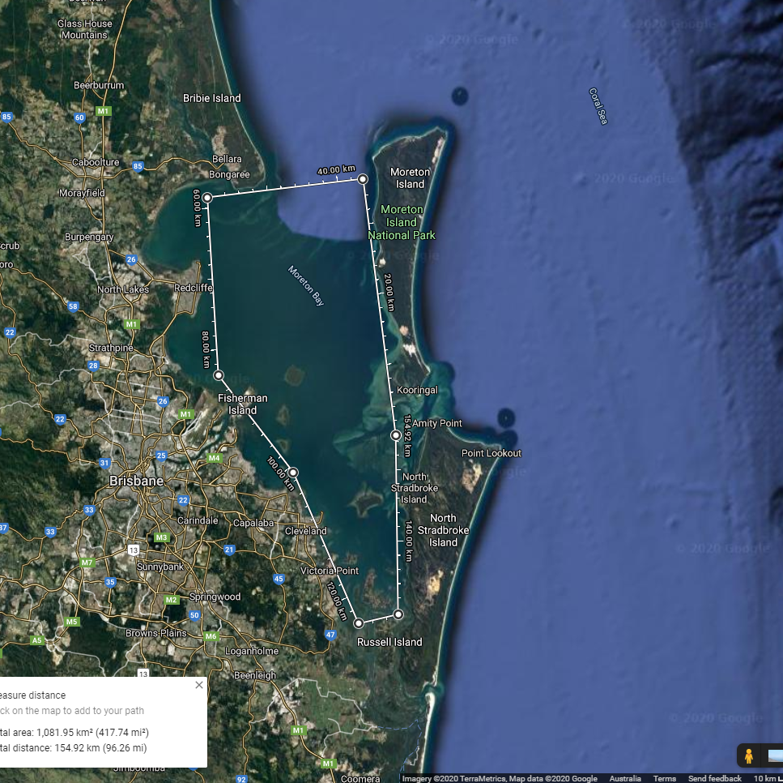
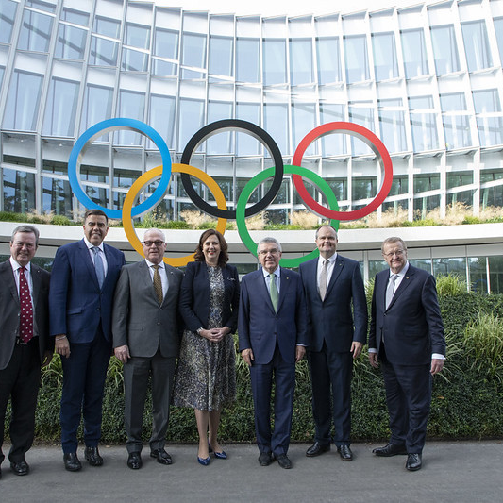
Long Term Civilisation Plan 2032 to Infinity
Solve Existential Threats of Life on Earth to ensure longevity of human civilisation. Consider that Earth is a water planet with a history of being frozen or melted, pelted by space rocks, ionized by solar mega flares, CME’s and even micro nova events. It’s sky’s blocked out by volcano eruptions, it’s oceans pushed over entire continents from radical earthquakes and the poles re-positioning.

Slide 8
How to Find Our 500 Queens
Education Industry
Industry referrals
Broad Spectrum
Guest Lectures at Universities
Recruiting Faculty to Nominate
High School Seniors: Visitor Days
Teacher Superannuation Mail-Lists
Teacher Unions Mail-Lists
Women in Business Networking
Women in Technology Networking
Women in Leadership Protégées
Women in Science Networking
Women in Finance Networking
Women in Legal Networking
Women in Philosophy and the Arts
Mainstream Media Interviews
500 Queens Meetup Groups
Jobs Fairs and Expos
Targeted Social Media Ads
Online Mixed Media Content
Beauty Pageant All Rounders
Quarterly Magazine & a Book

Slide 9
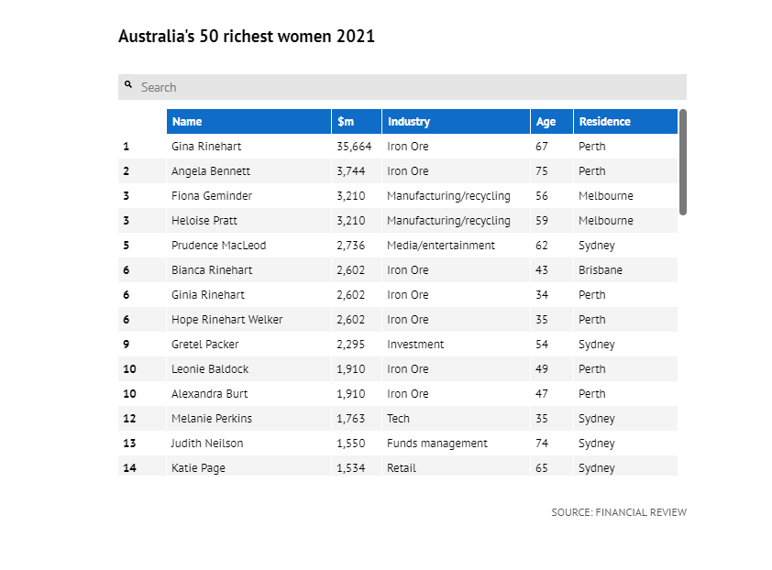

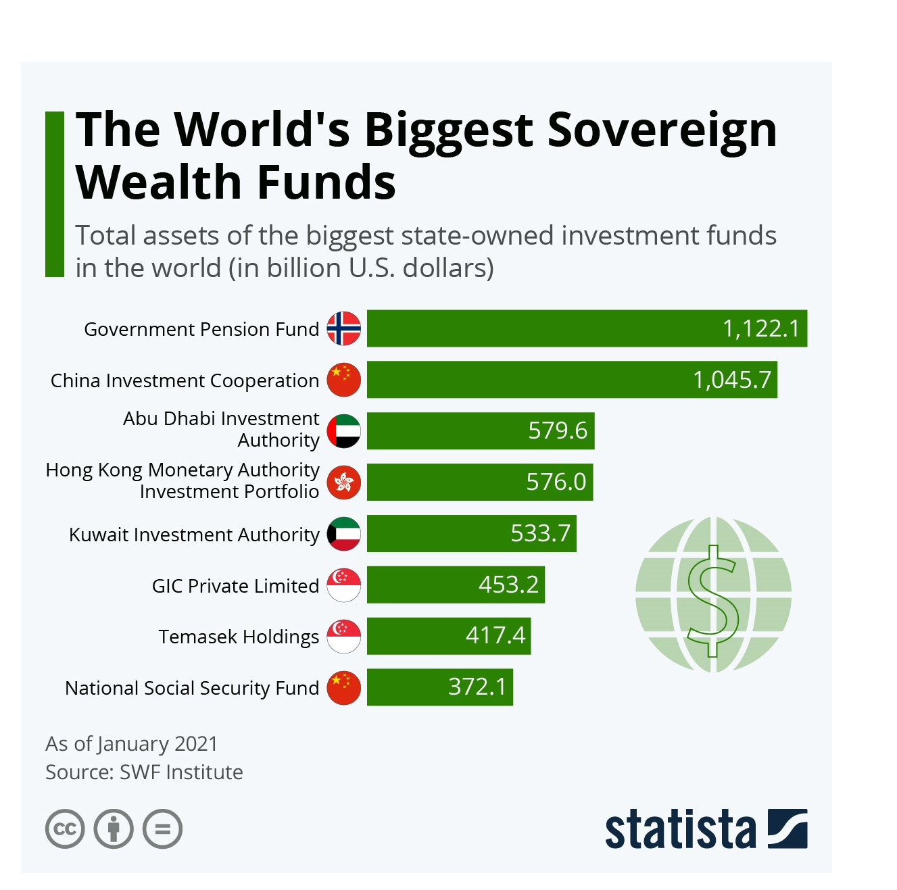
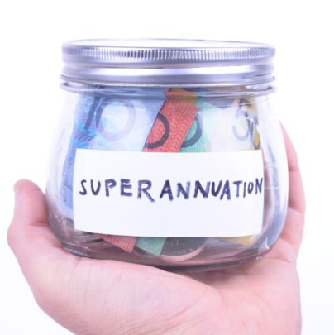
Investor Profiling
Superannuation Funds: ½ Women
University Endowment: ½ Women
Sovereign Wealth Funds: ½ Women
High Net Wealth: Prioritize Women
Insurance Funds: ½ Women
Pro Women Crypto Funds and Stakes

Slide 10
$50,000 Pre-Seed Start-up Grant
100 per year = 500 over 5 years.
Start-up Tools
Facilities and Services
A Virtual Reality Ready Computer
A Professional Virtual Reality Headset
A Standalone Virtual Reality Headset
An Augmented Reality Headset
A Suite of Necessary Software
Smart Devices Appropriate to Needs
Free Office Space for 3+ days per week
In-Kind Guidance & Professional Training
Priority Attendance at Regular Events
Travel Opportunities and Conferences
Media/Marketing Support and Insurances
Series A Investment Guarantee

Slide 11
Investment Fund Development
Work in Progress:
Seed Fund: No Equity
Series A Fund: Equity
Series B+ Fund: Equity
$30 Million over 5 years
  $6 Million per year
    $1 Million Management
    $5 Million Investments
      100 x $50,000
Total 500 Start-ups over 5 years
Repeat x 20 in G20 Nations
$500 Million to $10 Billion
  $200,000 to $10 Million each
If Just Series A for Australia, then smaller fund, but if also series A for the G20 syndication of 500 Queens to reach 10,000 Queens, then a much larger fund will be required.
5% Management, 30% / 70% split of returns over 10%
Bigger than Softbank Vision Fund
  Minimum $100 Million each
  Maximum $10 Billion each
1% Management, 30% / 70% split of returns over 10%
In 1st 500 Start-ups = >20 Unicorns
In 10,000 Start-ups = >100 Unicorns
Dutch Auction Exits and IPO’s

Slide 12
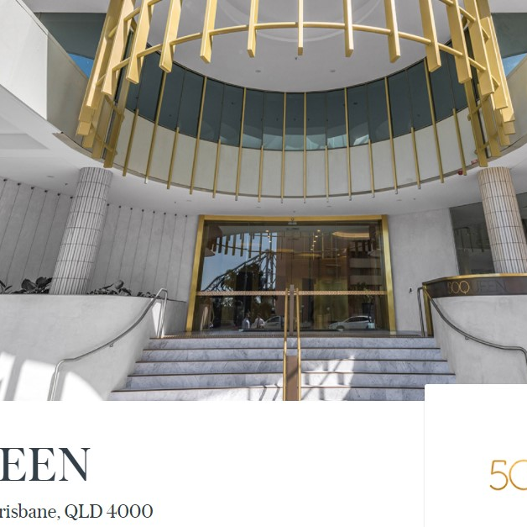

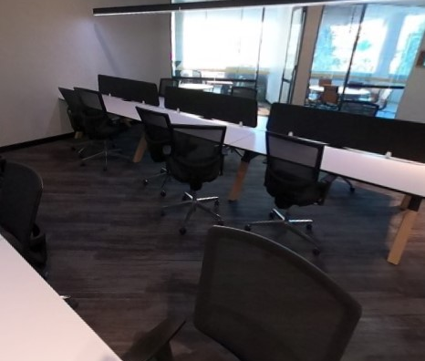
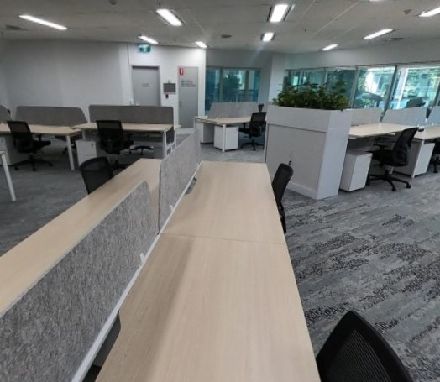
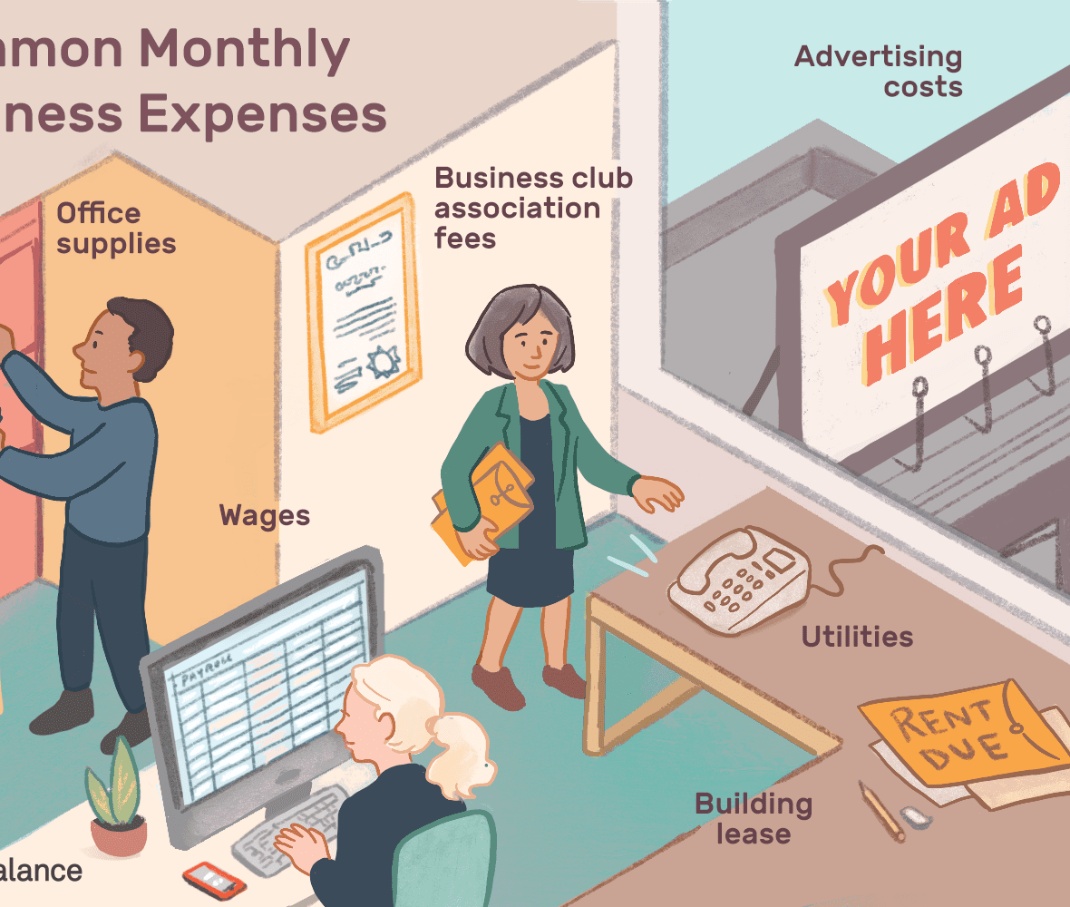
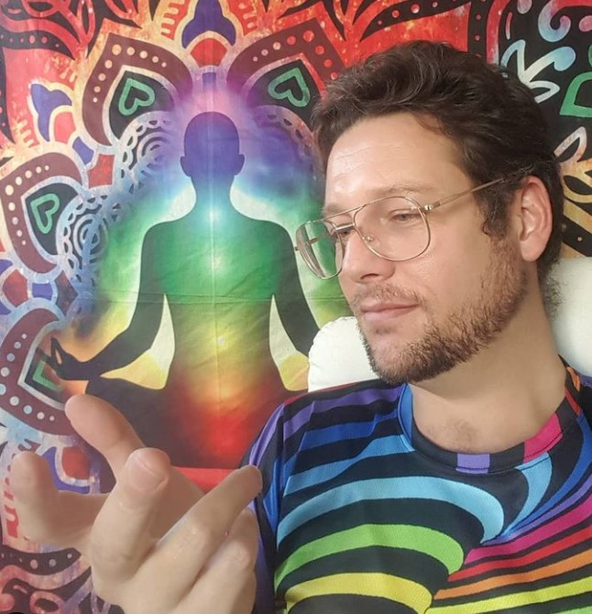
Major Costs
Incubator & Accelerator
Sponsored Weekly Meetups
Assisted Company Registrations
Just-In-Time Content Delivery
Local Legends Introductions
Global Legends Virtual Meetings
Sponsored In-Kind Services
St.
133m2 Offices
588m2 Offices
Overheads
Management
$83,000. Incentive also available.
$365,000. Incentive also available.
Promo, events and running costs
$100K-$200K me,
E/A $60K-$80K

Slide 13
0 to 30 of 120 Start-up Suggestions
These can be used as a guide to investment strategy
Simulations & Robots
Simulations & Robots
Clean Power Systems
Aged Care Support Systems
NDIS Support Systems
Smart City Capsule Hotels
Smart City Quarantine Hotels
Automated Fleet Cleaning
Frozen Food Warehouse Systems
Space Port Island Construction
East Coast Under Ocean UFRT
Cinematic Universe Simulations
Space Weather Modelling
Near Earth Object Mapping
100K Solar System Satellite Web
Off World Mining and Refining
Earthquake/Volcano Prediction
Quantum Computing Frameworks
Global Governance Networks
Fukushima Extreme Robotics
Subterranean City Building
Live Aid 2025 Cities >50K people
Live Aid 2025 Artistic World Vote
Tidal and Wave Power
Solar Desalination Bubbles
Mid Level Plasma Fusion
Pumped Water Storage
Battery Technology
Superchargers
Solar Concentration Furnaces
Bladeless Wind Turbines
Gravity Power
Hydrogen

Slide 14
30 to 60 of 120 Start-up Suggestions
Closed Loop Food
Waste Reclamation
Subterranean cities
Insects
Seafood
Seaweed
Superfoods
Mushrooms and Fungi
Legumes
Bacteria and Viruses
Poultry
Medicinal Plants and Spices
Food Compute/Produce DAO
Plastics and Glass
Nuclear Waste and Water
Industrial Process Biproducts
Solid Waste Refuse Tips
Human Waste and Life Support
Farming Process Biproducts
Subterranean City Displaced Muck
Mining Process Biproducts
Water Pollution
Computer E-Waste
DNA RNA Embryo Ark
Drilling, Tunnelling, Lateral Mining
Minimum, Ideal, Maximum Limits
Eternal Maintenance
Ultra Fast Transport
On Demand Production
Eternal Human Life Support
Resurface & Expansion Planning
Gamification of Governance
Olympic Scale Entertainment

Slide 15
60 to 90 of 120 Start-up Suggestions
Extreme metamaterials
Space Industry
Micro-Architectures
Superconductors
Polymers
Perfect Crystal Growth
Ceramics
Anodes and Cathodes
Electrolytes
Resonators
Absolute Vacuums
Extremely Precise Lasers
Extreme Magnetism or Levitation
Second Skin Space Suits
Radiation Protection Systems
Radiation Remediation Systems
3D Metallic Printers/Welders
Starship Size Mining Payloads
Starship Size Deep Space Payloads
Starship Size Eternal Life Support
Subterranean City Designs
Interstellar Warp or Portals
Plasma Fusion in Space
Sensors and Switches
System on a Chip
Quantum Computers
Micro Fluidics
Solid State Crystal Compute
Rubidium Quantum Compute
Molecular Machines
Claytronics
Near Eye Light Field Displays
Quantum Entanglement

Slide 16
90 to 120 of 120 Start-up Suggestions
Humanities and fun
Market Analysis
Aura of Intelligence
Cinematic Universe
Just-In Time Learning
Radical Life Extension
Micro Biome Mastery
Sex and Sexual Education
Matrimony of Many
Game Design School
Mental Health Support
Creativity and Performance Art
Philosophy and Life Long Learning
Aged Care and NDIS
Education and Training
Mental Health & Happiness
Physical Health & Living Standards
Migration & International Students
Pandemics, Plagues & Ext. Weather
Agriculture and Aquaculture
Housing and Tourism
Population Stability
Governing Protocol & Confidence
500 Queens: Aura Framework
Aura Events on NVIDIA DGX1
Queens Wharf Conscious A.i. Art
Magic Mirror Conscious Aura
Millionaire Aura
Billionaire Aura
Intimate Values Underwear
NDIS Aura Development
Aged Care Aura Development
Female Prisoner Rehabilitation

Slide 17
Start-up Timeline: 8 Months < ∞
Start-up
1 Month Fund Launch
1st 100 Queens Search
Events & Office Fit Out
Momentum
3 Months
Govt. & Private Partnerships
Prototype, Launch, Feedback
Cascade
1 Month
Series A Funding
Growth, Growth, Growth
Intermission
Next Gen
2 Months
Celebrate 1st 100 Queens
Commence G20 Syndication
1 Month
Work Smart Ecosystem
Diversify, Evolve, Assist Others

Slide 18

Believe It,
Become It.
Are You In?
I dare to believe this will become the most successful start-up ecosystem in the history of modern human civilisation as all participants master honest communication and the principal virtues of hope, empathy and joyful responsible abundance.

Slide 19


Thank You
Luke Catalyst Nathan Hayes
webmaster@iSeeinfinity.com
https://500QueensVC.com

